Slide 1
AIML CA1 Part A
By Davian

Slide 2
Overview Of The Workflow
Data Preprocessing
Tuning Hyperparameters Of Models
Model Validation
Conclusion
Evaluating Chosen Model
Model Selection

Slide 3
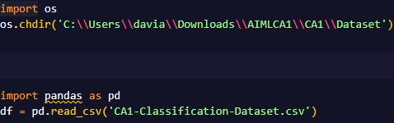
Importing Data
Using the Pandas module to import the classification dataset

Slide 4
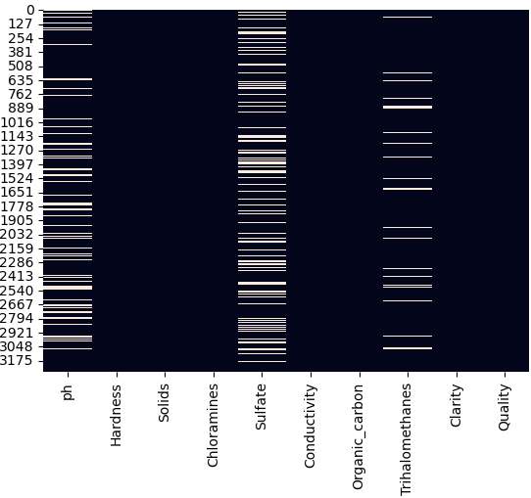
Preparing the Data
I decided to not drop any features as I think that every column is needed
Sulfate has the highest count of missing data at 781.
But because only 23.8% of the column is missing, it would not be beneficial to drop the column as 80% of data would go to waste if I had done so.
Instead, I will just impute the data with the median value along with the other columns with missing values

Slide 5
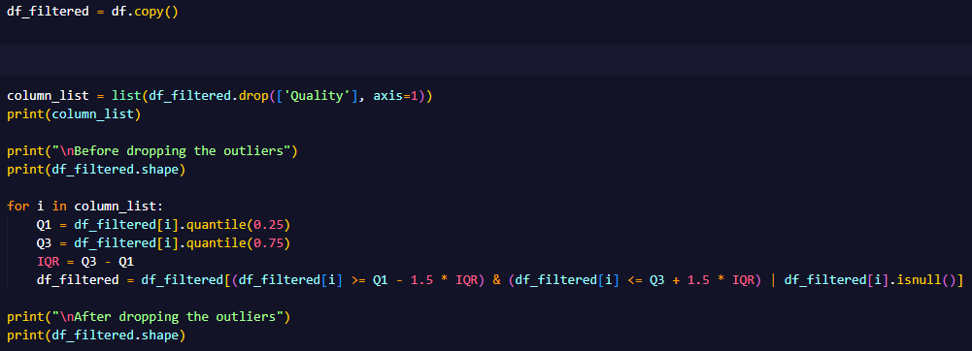
Dealing With Outliers
We will make 2 separate datasets, one with the outliers in it and the other without outliers in it.

Slide 6
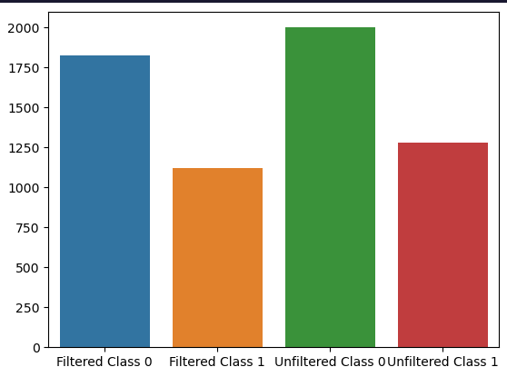
Dataset Class Balance
As we can see there is a class imbalance in the dataset.
About 60% of the data has the target value of 0 while the remaining has the target value of 1.

Slide 7
Train Test Split
The next step is to do train test split on both the filtered and unfiltered dataset.
We want to train test split before imputing missing data values and scaling so that no information from the testing set leaks into the training set.
As there is a class imbalance and therefore, stratify is needed in train_test_split

Slide 8
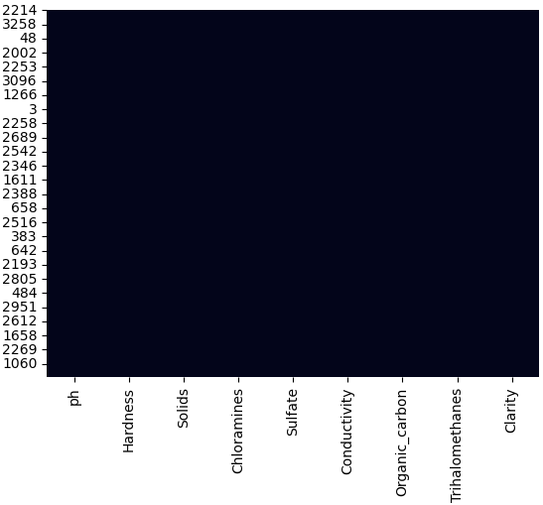

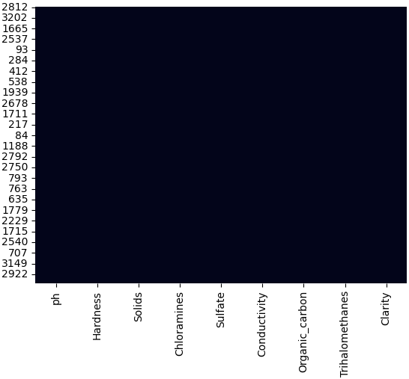
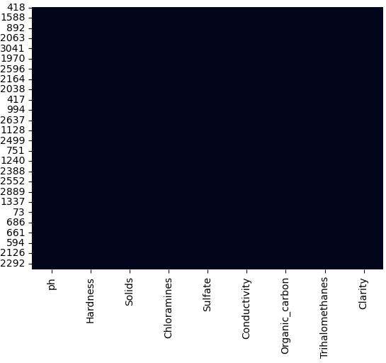
Data Imputation
Now, I will impute missing data for x train and x test in both the filtered and unfiltered dataset with the median value.

Slide 9
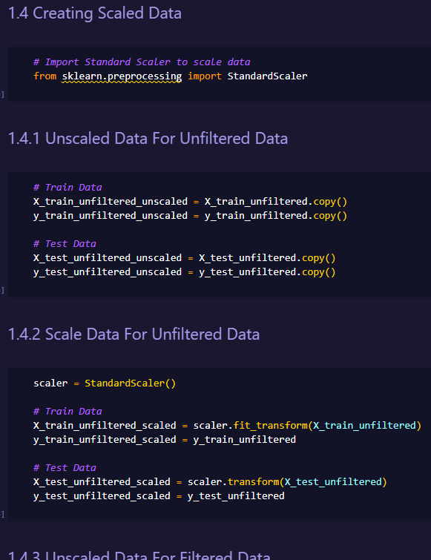
Scaling The Dataset
I will now create 2 sets of data from each of the filtered and unfiltered data set.

Slide 10
All Data Set Variants
In summary, I have created 4 datasets as listed below
Filtered and Unscaled
Filtered and Scaled
Unfiltered and Unscaled
Unfiltered and Scaled

Slide 11
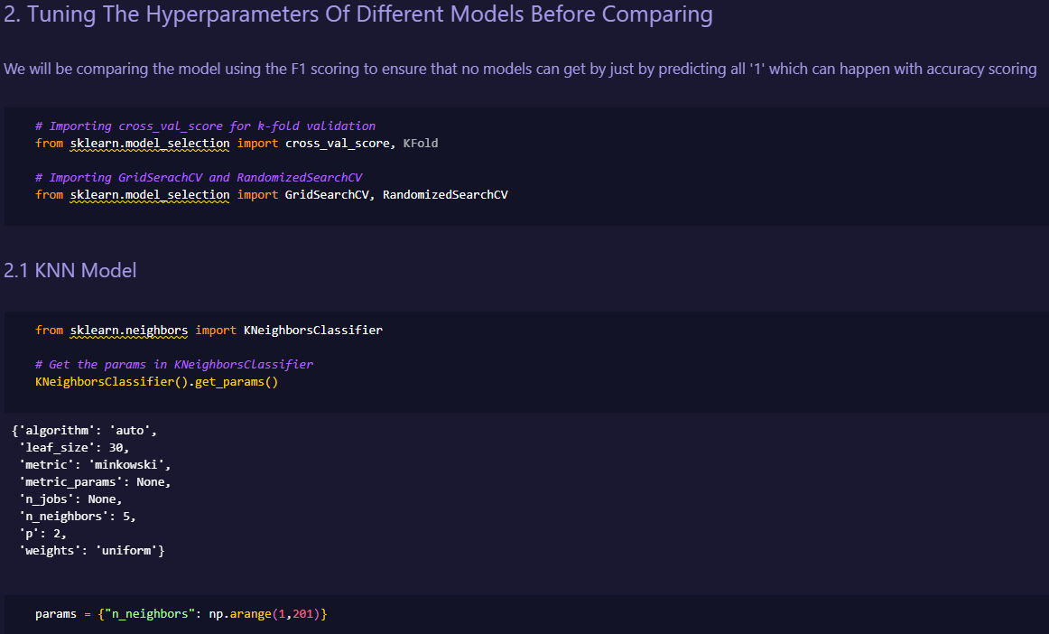
Tuning Hyperparameters Of Models
Now, we are in the process of tuning the hyperparameters of the chosen models.
I will tune the hyperparameters of each model 4 times, one for each dataset variant.
I have set scoring to ‘f1_weighted’ to account for the class imbalance and as f1 is better than accuracy as it also considers the false positives and false negatives.

Slide 12
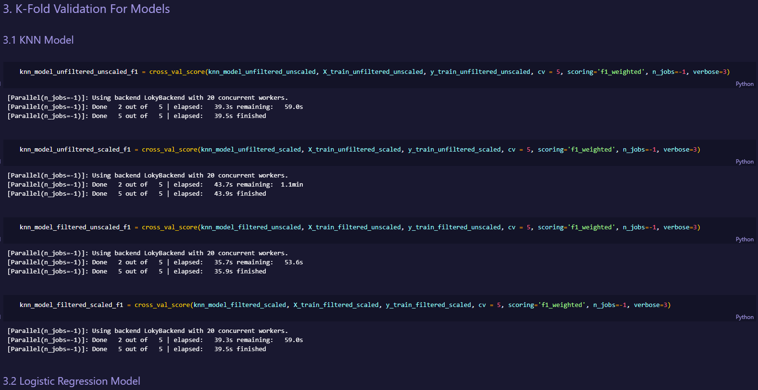
Model Validation
Now that the models hyperparameters are tuned, I will now do k fold validation on those model so that I can compare all model’s f1 weighted score.

Slide 13
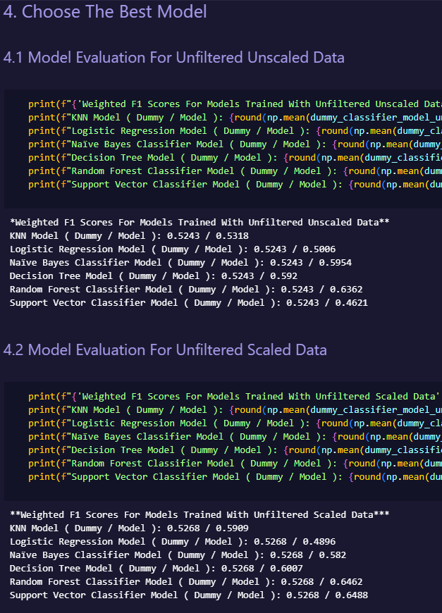
Model Selection
Now that I have gotten the scores on how each model perform on each of the dataset variant, I will now choose the model with the highest f1 weighted score.

Slide 14
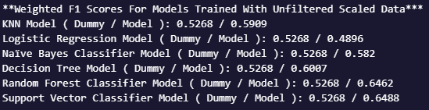
Choosing The Best Model
From looking at the results, the best model found is the SVC Model trained on unfiltered scaled with an F1 weighted score of 0.6488
The SVC Model’s f1 score is higher than the dummy baseline by 23.2%

Slide 15
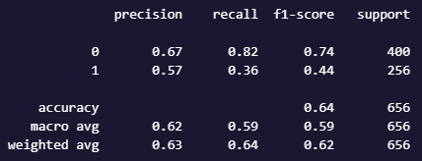
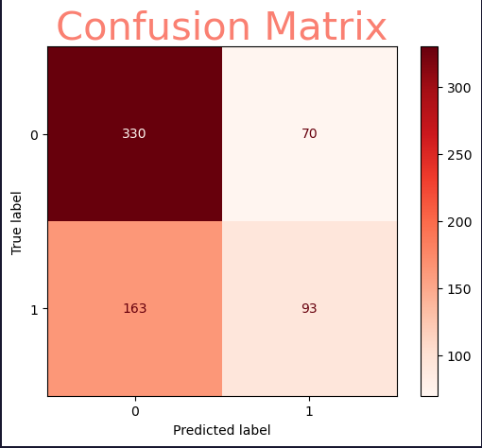
Evaluating The Chosen Model
Now I will test the model by making it predict on the x test and evaluating its results

Slide 16
Conclusion
In conclusion, we created 4 variants of the dataset, tuned the hyperparameters of all our models according to each of the four dataset and then did k-fold validation on each of the tuned models and chose the best model of them all after which, tested it on the test data.
The best model for this dataset is the SVC Model trained on unfiltered scaled with an F1 weighted score of 0.6488.

